Slide 1
CSE-421
Computer Graphics: Homogeneous Coordinates
Lecture-02
Lecturer, Varendra University

Slide 2
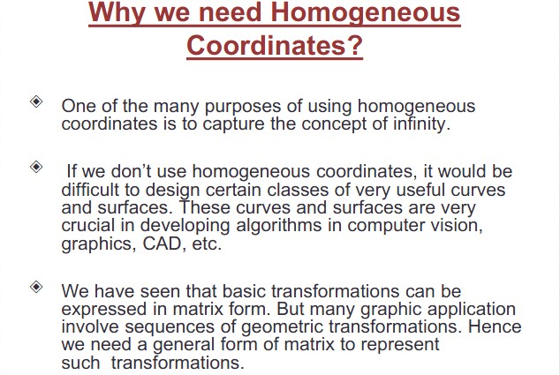
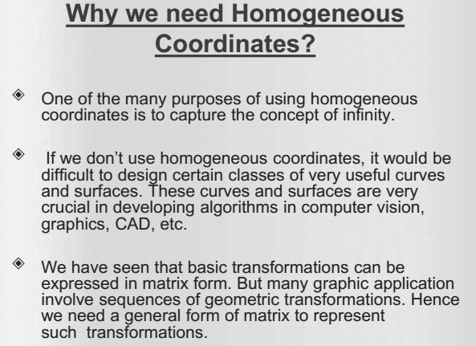

Slide 3
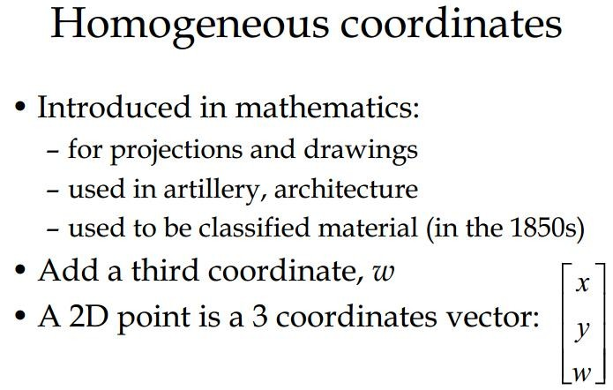

Slide 4
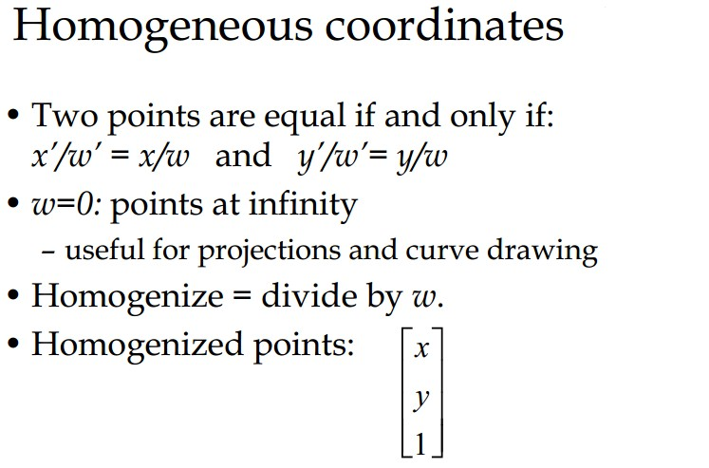

Slide 5
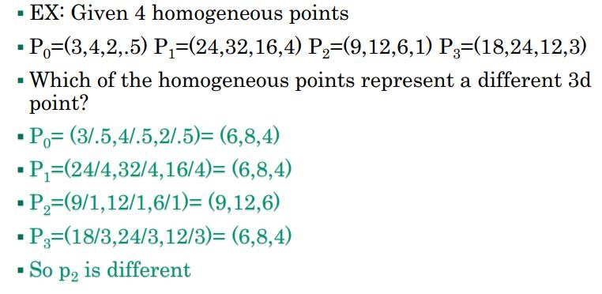

Slide 6
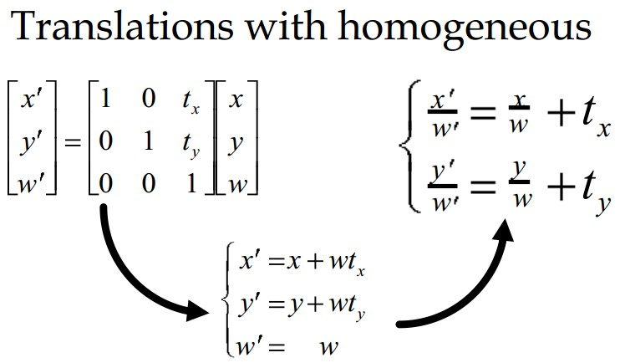

Slide 7
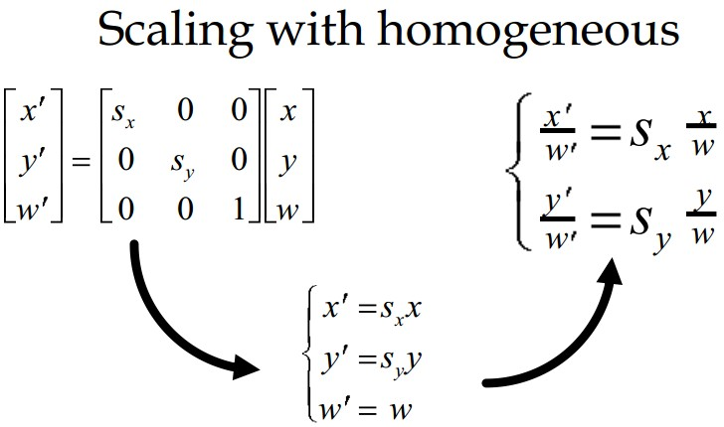

Slide 8
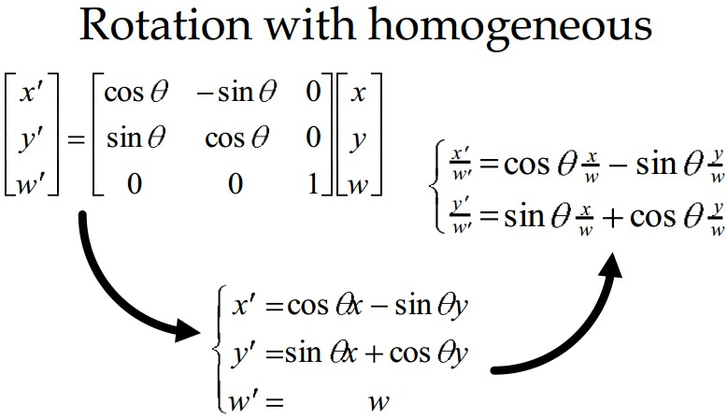

Slide 9
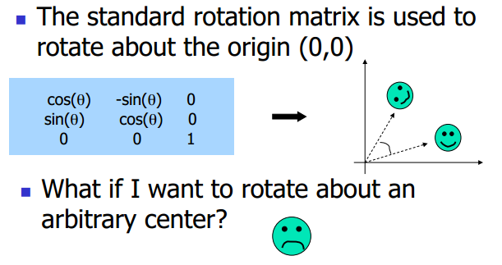
Rotation Revisit

Slide 10
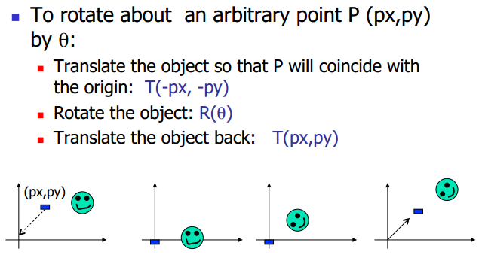
Arbitrary Rotation Center

Slide 11
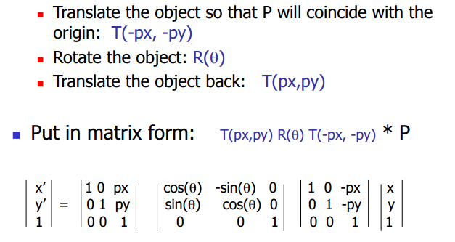
Arbitrary Rotation Center

Slide 12
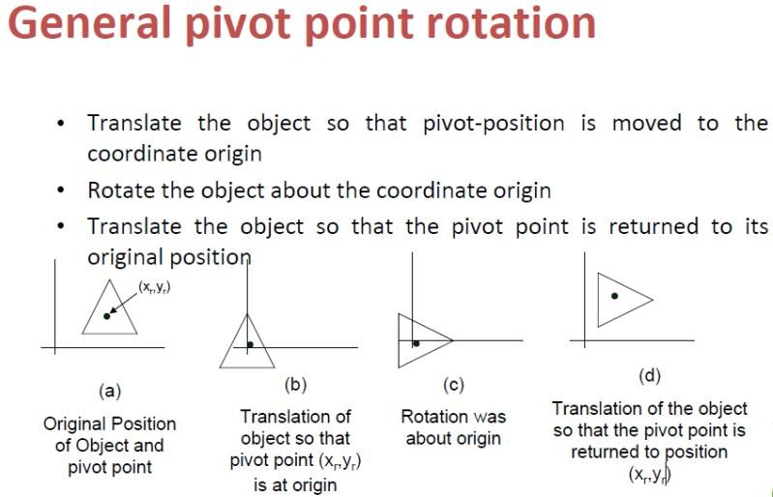

Slide 13
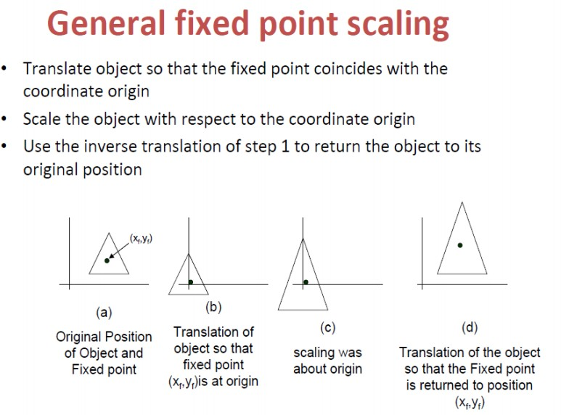

Slide 14
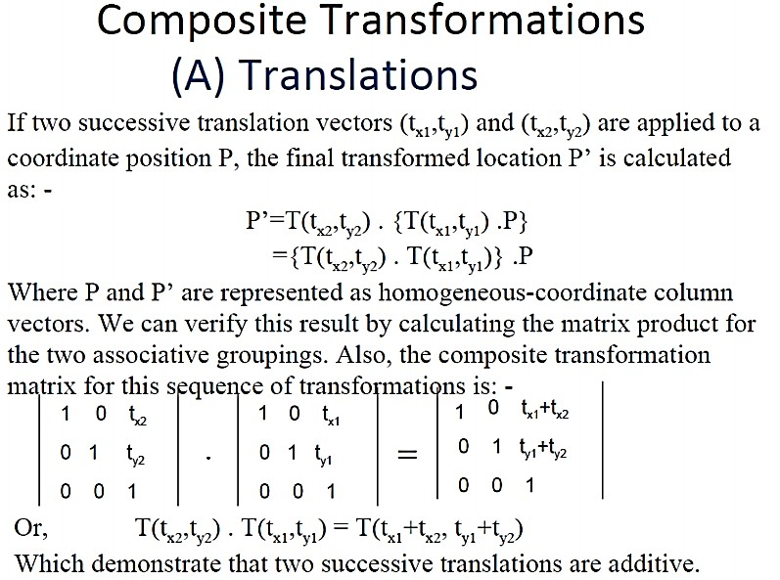

Slide 15
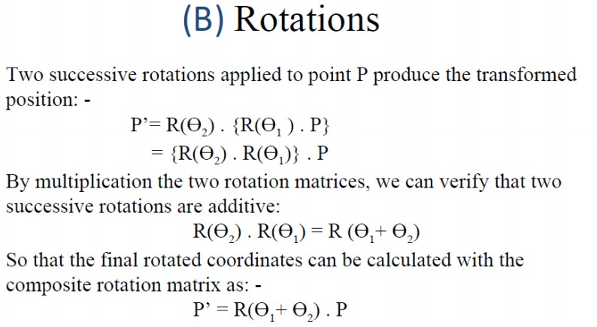

Slide 16
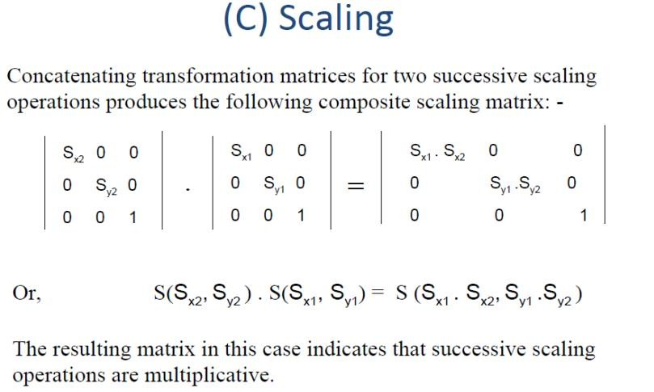

Slide 17
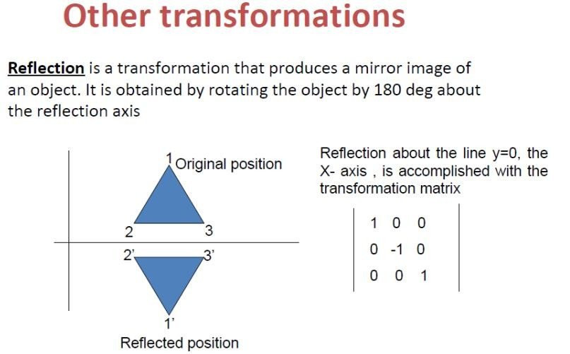

Slide 18
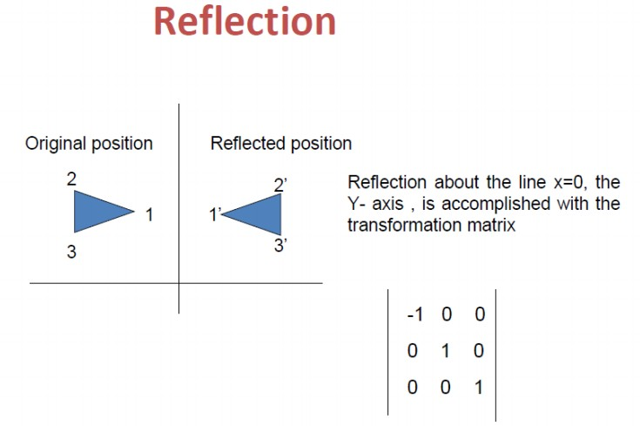

Slide 19
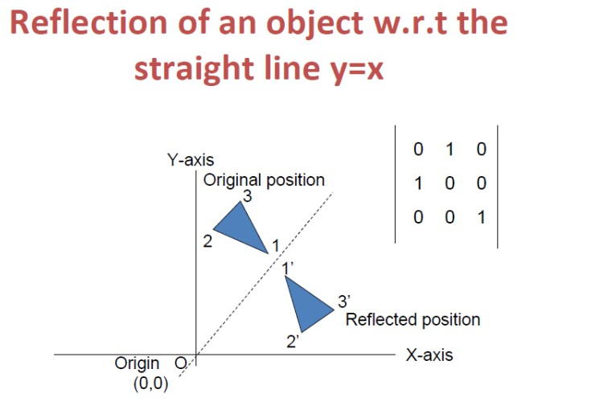

Slide 20
Reflection About an Arbitrary Line:
Translate line to the Origin.
Rotation about the Origin.
Reflection Matrix.
Reverse the rotation.
Translate line Back.
𝑻 𝟎, 𝒃 . 𝑹_{𝜽} . 𝑹𝒇_{𝒙} . 𝑹_{−𝜽}. 𝑻(𝟎, −𝒃)
[ when, y=mx+b ]
Note: If the line passes the origin we need only 3 Steps (remove step 1 and step 5).

Slide 21
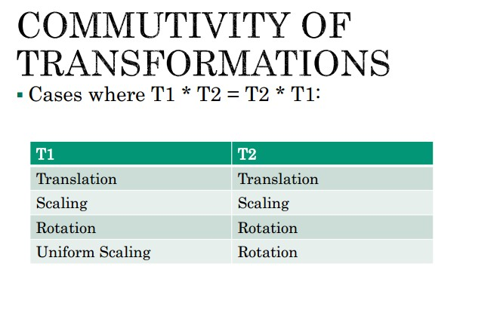

Slide 22
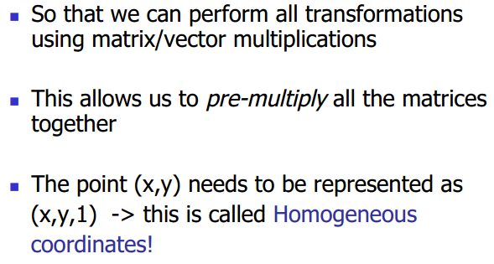
Why use 3x3 matrices?

Slide 23
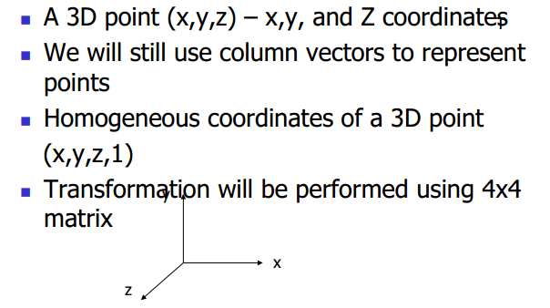
Three-Dimensional Graphics

Slide 24
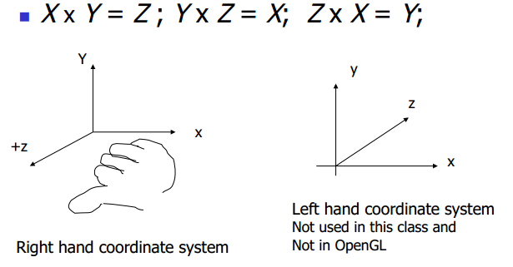
Right hand coordinate system

Slide 25
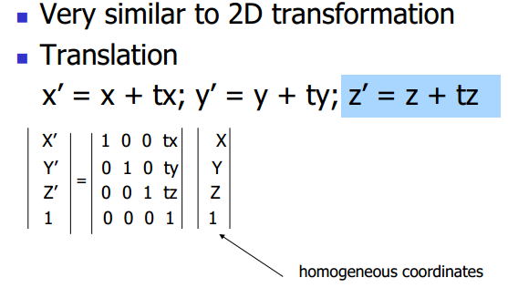
3D transformation

Slide 26
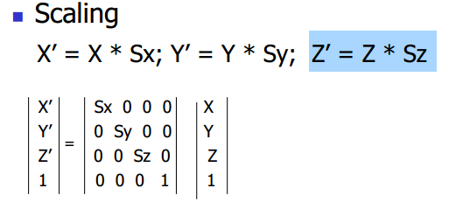
3D transformation

Slide 27
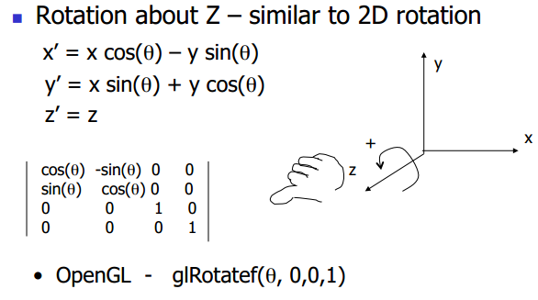
3D transformation

Slide 28
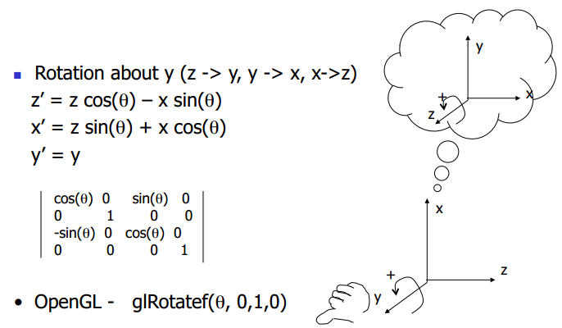
3D transformation

Slide 29
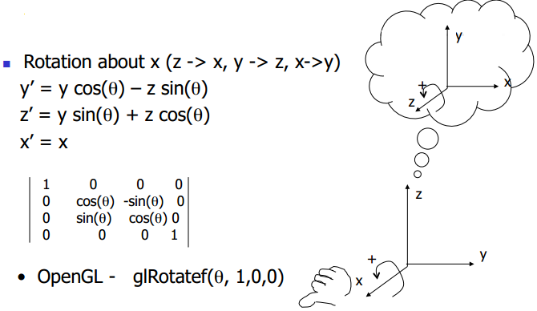
3D transformation

Slide 30
Thank You

